Slide 1
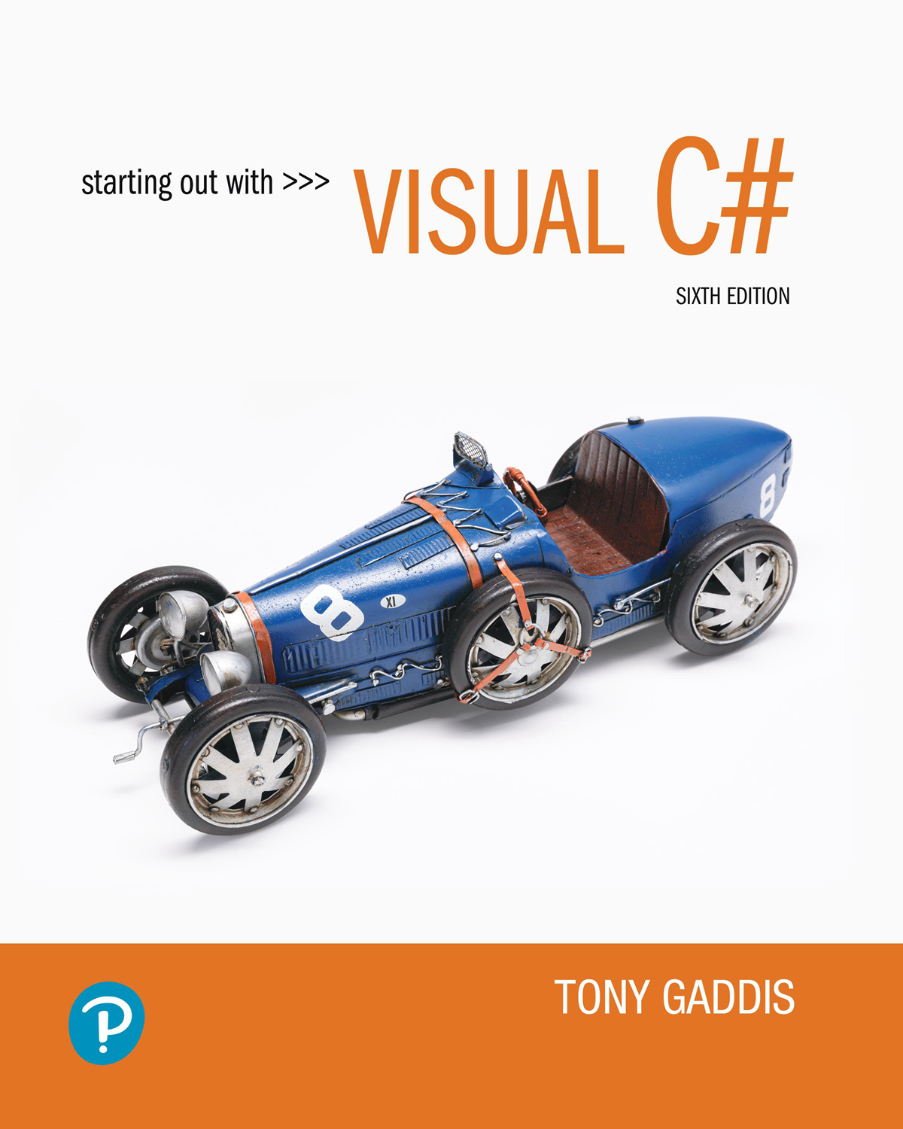

Starting Out with Visual c sharp
Sixth Edition
Chapter 1
Introduction to Visual c sharp
Copyright © 2023, 2017, 2014 Pearson Education, Inc. All Rights Reserved
Notes:
If this PowerPoint presentation contains mathematical equations, you may need to check that your computer has the following installed:
1) MathType Plugin
2) Math Player (free versions available)
3) NVDA Reader (free versions available)

Slide 2
Topics
1.1 Objects
1.2 The Program Development Process
1.8 Getting Started with Visual Studio
2.1 Getting Started with Forms and Controls
2.2 Creating the G U I for Your First Visual C# Application
2.3 Introduction to C# code
2.4 Writing Code for the Hello World Application
2.5 Label Controls
2.6 Making Sense of IntelliSense
2.7 PictureBox Controls
2.8 Comments, Blank Lines, and Indentation
2.9 Writing the Code to Close an Application’s Form
2.10 Dealing with Syntax Errors

Slide 3
1.1 Objects
An object is a program component that contains data and performs operations, Programs use objects to perform specific tasks.
Most programming languages use object-oriented programming in which a program component is called an “object”
Program objects have properties (or fields) and methods
  Properties – data stored in an object
  Methods – the operations an object can perform
Notes:
Wage calculator is the form object. The dialog box consists of 2 label objects with corresponding text box objects, and two button objects. The label objects read as follows. Number of hours worked and hourly pay rate. The button objects read as follows. Calculate gross pay and exit.

Slide 4
Controls
Objects that are visible in a program G U I are known as controls
  Commonly used controls are Labels, Buttons, and TextBoxes
  They enhance the functionality of your programs
There are invisible objects in a G U I such as Timers, and OpenFileDialog
A class is code that describes a particular type of object

Slide 5
.NET Framework
.NET is a collection of classes and other code that can be used to create programs for Windows operating system
is a language supported by .NET
Controls are defined by specialized classes provided by .NET
You can also write your own class to perform a special task

Slide 6
1.2 Getting Started with Visual Studio (1 of 5)
Visual Studio is a professional integrated development environment (I D E)
The Visual Studio Environment includes:
  Designer Window
  Solution Explorer Window
  Properties Window

Slide 7
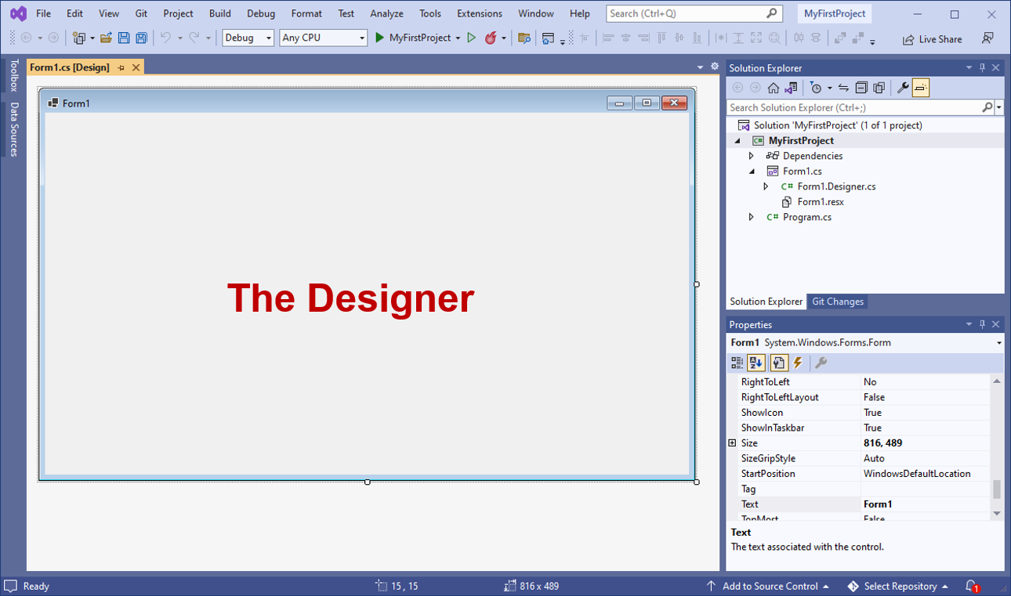
1.3 Getting Started with Visual Studio (2 of 5)

Slide 8
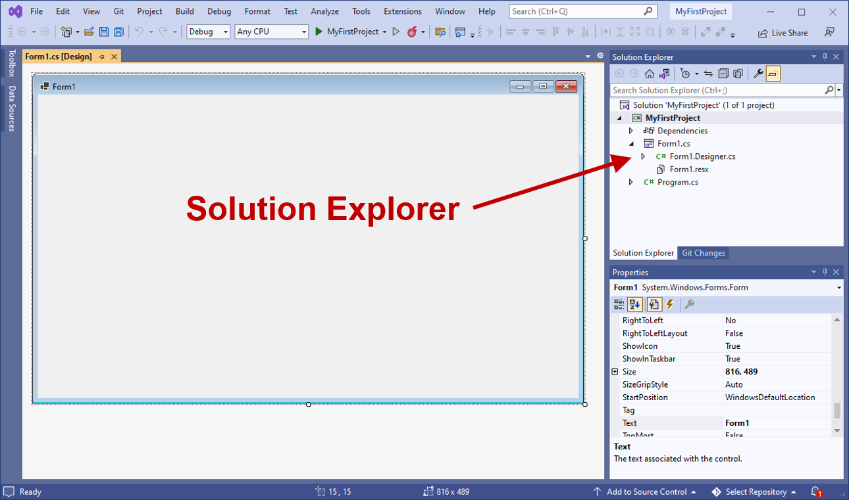
1.3 Getting Started with Visual Studio (3 of 5)
Notes:
There are three panes. An arrow indicates the topmost right pane, the solution explorer. The solution explorer lists the project as a nested expandable list. Sub menus in the solution explorer include properties, references, and form 1.

Slide 9
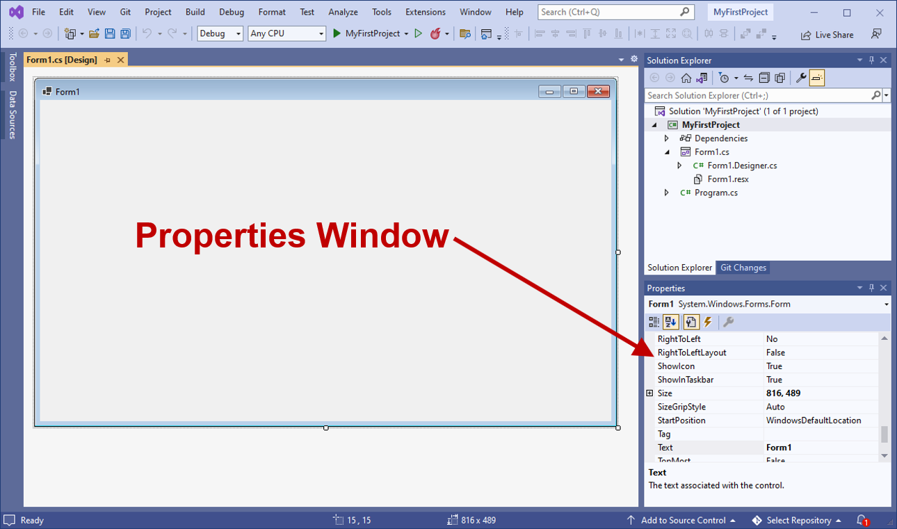
1.3 Getting Started with Visual Studio (4 of 5)

Slide 10
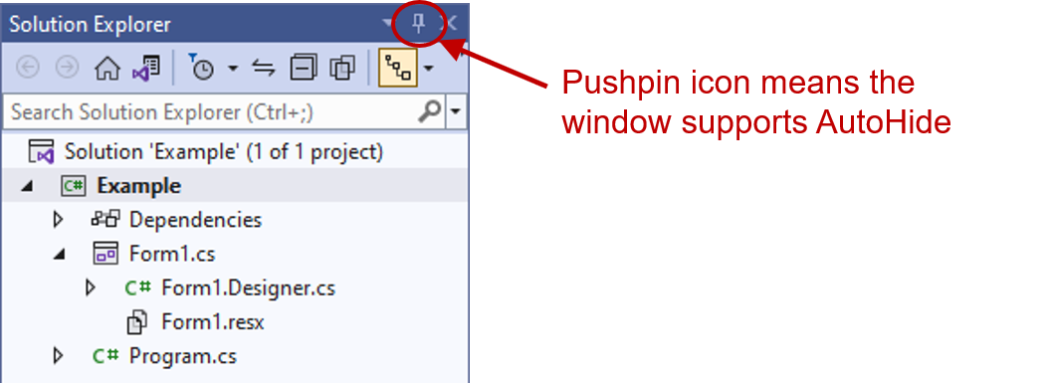
1.4 Getting Started with Visual Studio (5 of 5)
Auto Hide allows a window to display only as a tab of the edges

Slide 11
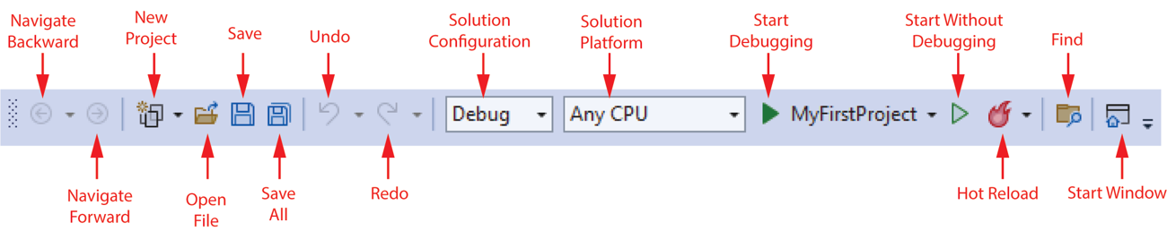
Menu Bar and Standard Toolbar
Menu bar provides menus such as File, Edit, View, Project, etc.
Standard toolbar contains buttons that execute frequently used commands
Notes:
left arrow, navigates backward. Right arrow, navigates forward. Two papers with a star, new project. Folder opening, open file. Floppy disk, save. Two floppy disks, save all. Arrow going backward, undo. Arrow going forward, redo. Debug field with a down arrow, solution configuration. Any C P U field with a down arrow, solution platform. Right arrow next to the word Start, start debugging. Folder with magnifying glass, find.

Slide 12
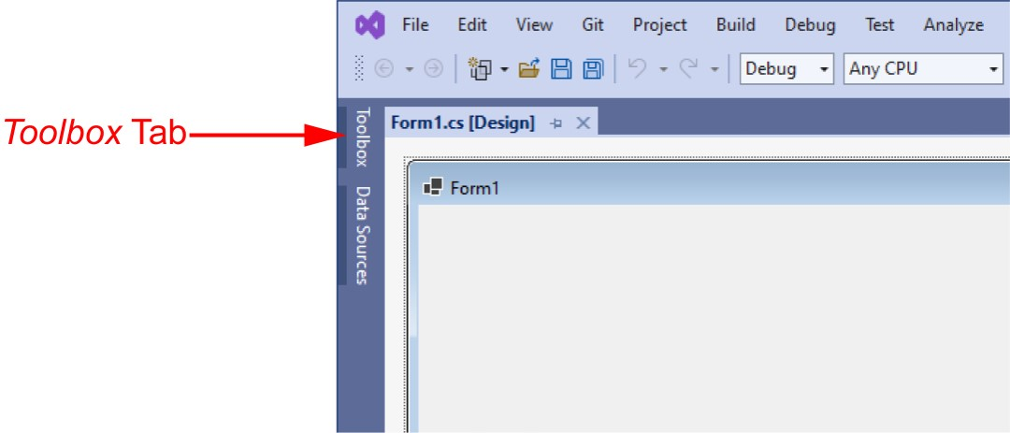
The Toolbox (1 of 2)
Toolbox is a window for selecting controls to use in an application
  Typically appears on the left side of Visual Studio environment
  Often is in Auto Hide mode
Notes:
There is a menu bar and a navigation bar under the title. Under that is the form designer window with a blank form in it. The toolbox tab is oriented vertically on the left side of the window, above the data sources tab.

Slide 13
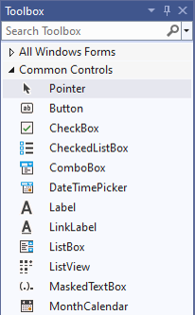
The Toolbox (2 of 2)
Toolbox is a window for selecting controls to use in an application
  Divided into sections such as “All Windows Forms” and “Common Controls”
Notes:
The first is, all windows forms. The second is, common controls. The common controls list is expanded and the controls are as follows. Pointer, button, check box, checked list box, combo box, date time picker, label, link label, list box, list view, masked text box, and month calendar.

Slide 14
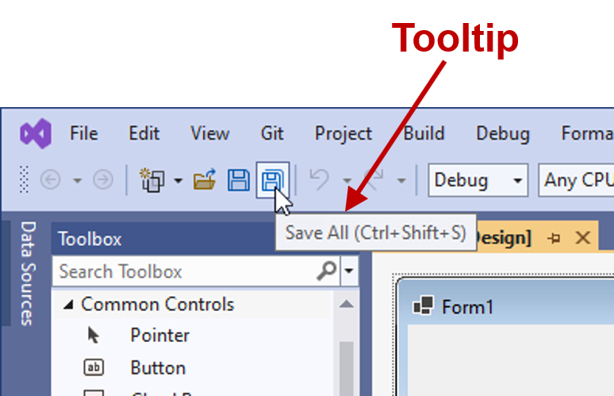
Tooltips
A Tooltip is a small box that pops up when you hover the mouse pointer over an item on the toolbar or toolbox.
Notes:
There is a menu bar and a navigation bar under the title. The left pane is the toolbox window and the right pane is the designer window. The cursor hovers over the save all icon in the navigation bar. The save all tooltip is displayed. The tooltip reads, save all, control plus shift plus S.

Slide 15
Docked and Floating Windows
When a window such as Solution Explorer is docked, it is attached to one of the edges of the Visual Studio environment
When a window is floating, you can click and drag it around the screen
  A window cannot float if it is in Auto Hide mode
Right click a window’s title bar and select Float or Dock to change between them

Slide 16
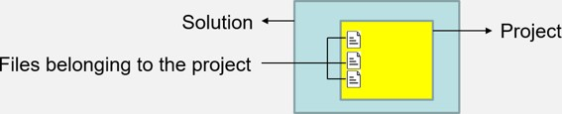
Projects and Solutions
Each Visual Studio application
you will create is
a project
  A project contains several files.
  Typically they are Form1.c s, Program.c s, etc.
A solution is a container that can hold one or more Visual Studio
projects
  Each project, however, is saved in its own solution
Notes:
Solution = entire container (can have many projects).
Project = one application inside the solution.
Files of project = the actual code and resources that make the application run.

Slide 17
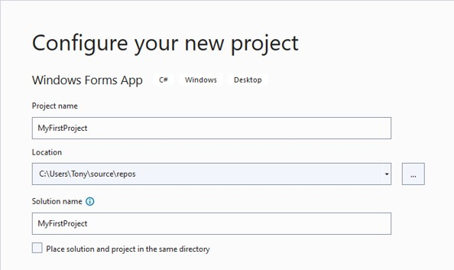
Specifying the Project Name
You can specify the project name the first time you save the project.
Notes:
The name is the project name, such as, my first project. The location is where the solution folder will be created. The solution name is, for example, my first project.

Slide 18
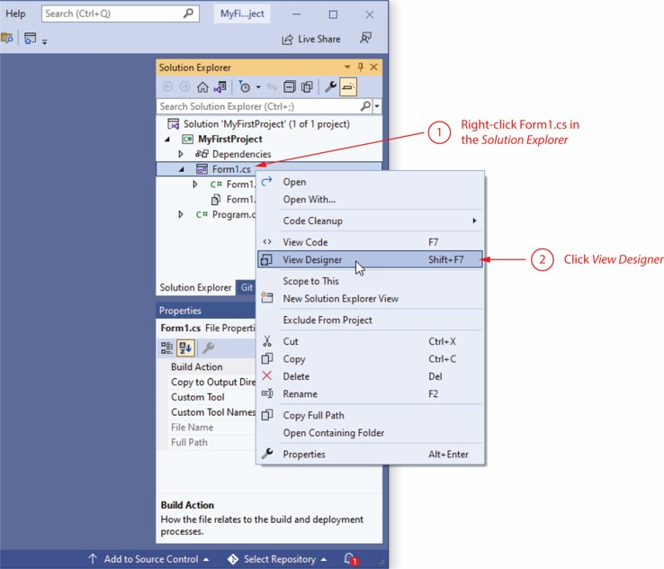
Displaying the Designer
Sometimes when you open an existing project, the project’s form will not be automatically displayed in the Designer
You should:
  Right click Form1.c s in the Solution Explorer
  Click View Designer in the pop-up menu
Notes:
1, right click form 1 dot c s in the solution explorer. The menu that opens from right clicking the form option lists options including, open, open with, view code, view designer, view class diagram. 2, click view designer.

Slide 19
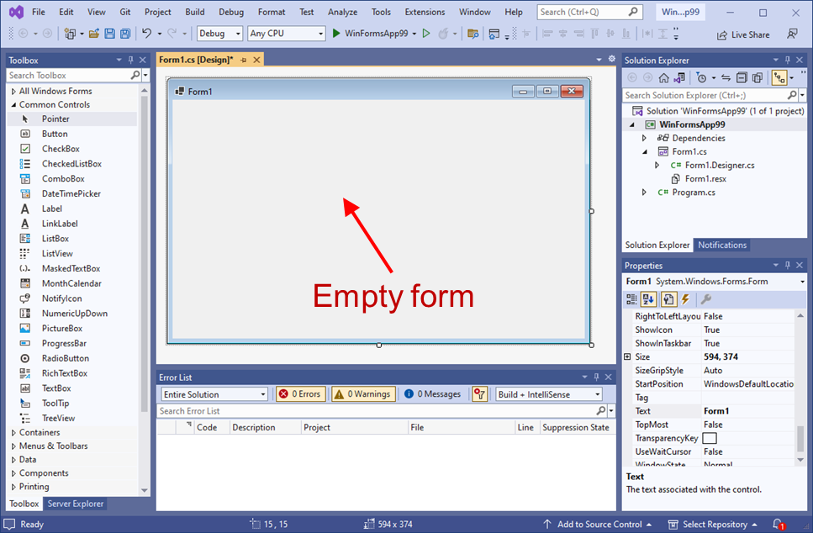
2.1 Getting Started with Forms and Controls
When you start a new
Windows Forms App, an empty
form named Form1 is automatically created.
Initially the form’s size is 300 pixels wide by 300 pixels high

Slide 20
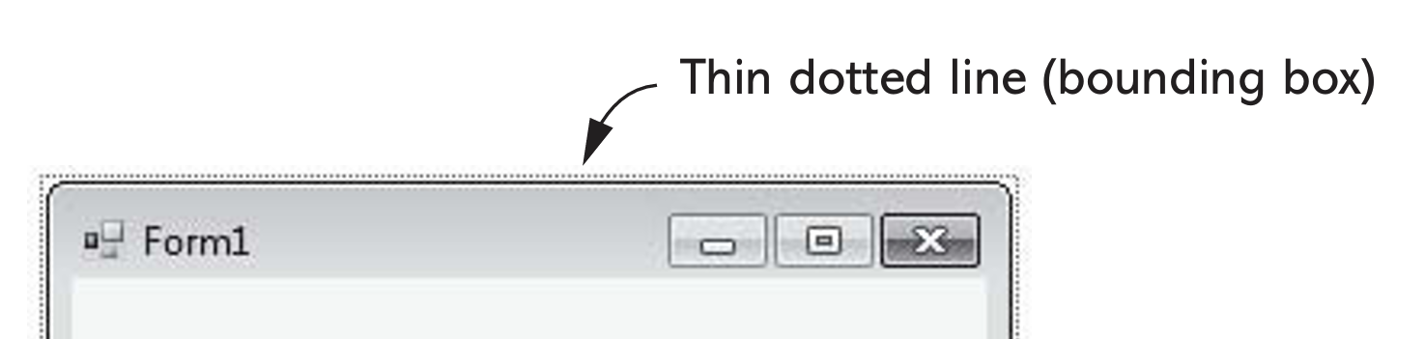
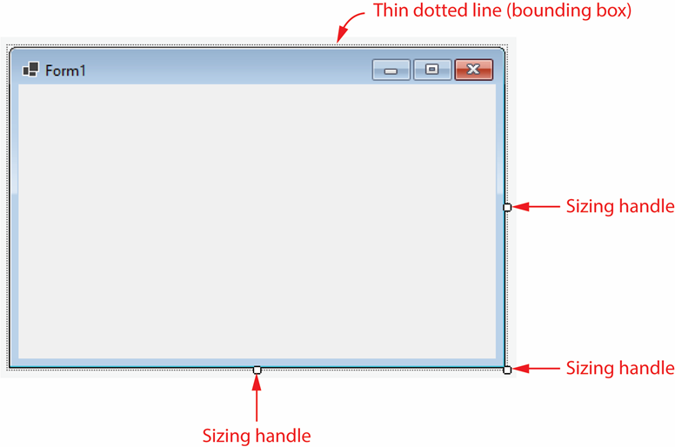
The Form’s Bounding Box and Sizing Handles
A form in Designer is enclosed with thin dotted lines called the bounding box
The bounding box has small sizing handles; you can use them to resize the form

Slide 21
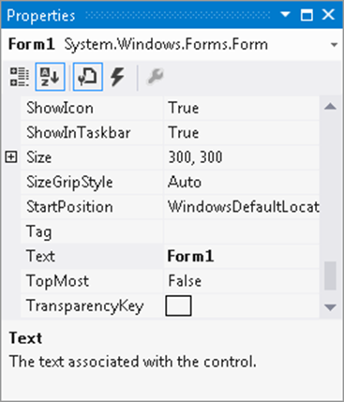
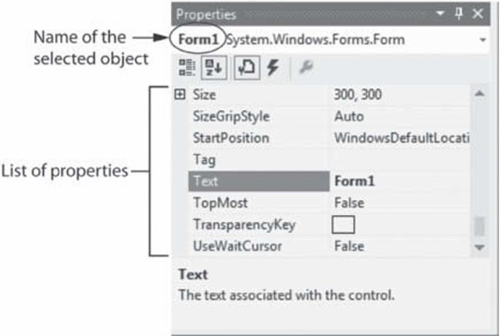
The Properties Window
The appearance and other characteristics of a G U I object are determined by the object's properties
  Properties are settings that control how the object looks and behaves
The Properties window lists all properties
  When selecting an object, its properties are displayed in Properties windows
  Each property has 2 columns:
    Left: property’s name
    Right: property’s value
Notes:
The left column lists the properties and the right column lists corresponding values. For example, for the property, show icon, the value is, true. For the property, size, the value is, 300 300. For the property, text, the value is, form 1.

Slide 22

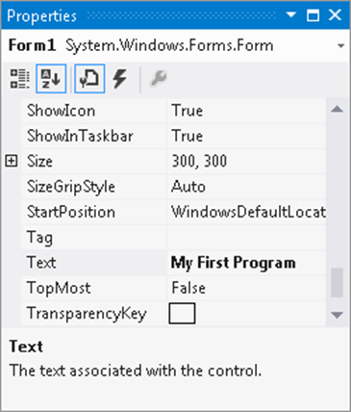
Changing a Property’s Value
Select an object, such as the Form, by clicking it once
If the Properties panel is not already visible, go to the View menu → Properties Window.
Find the property’s name in the list and change its value
  The Text property determines the text to be displayed in the form’s title bar
  Example: Change the value from “Form1” to “My First Program”
Notes:
Alphabetical button ( ) is selected near the top of the Properties window.
This causes the properties to be displayed in alphabetical order. Alternatively, the Categorized button ( ) can be selected, which causes the properties to be displayed in groups.
The Categorized listing is the default selection, and most of the time, it makes it easier to locate specific properties

Slide 23

Adding Controls to a Form
In the Toolbox, select the Control (e.g. a Button), then you can either:
  double click the Button control
  click and drag the Button control to the form
On the form, you can
  resize the control using its bounding box and sizing handles
  move the control’s position by dragging it
  change its properties in the Properties window
Deleting a Control
Deleting a control is simple: you select it and then press the key on the keyboard.

Slide 24
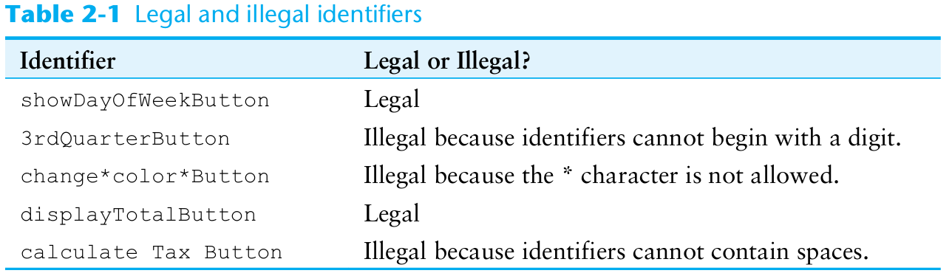
Rules for Naming Controls
Controls’ are identified by their names in code
Control names are also known as identifiers.
The naming rules are:
  The first character must be a letter (lower or uppercase, does not matter) or an underscore (_)
  All other characters can be alphanumerical characters or underscores
  The name cannot contain spaces
Examples of valid names are:
  showDayButton
  DisplayTotal
  _ScoreLabel
Notes:
Most C# programmers address this problem by using the camelCase naming convention for controls.
camelCase names are written in the following manner:
• You begin writing the name with lowercase letters.
• The first character of the second and subsequent words is written in uppercase.

Slide 25
2.2 Creating the G U I for Your First Visual c sharp Application
In section 2.2 you will start creating an app that has a Form and a Button control
When the app is finished, it will display the message "Hello World" when the Button control is clicked
In this section you will create the G U I
In section 2.3 you will learn the details of coding an app
In section 2.4 you will write the code that displays “Hello World” when the user clicks the button

Slide 26
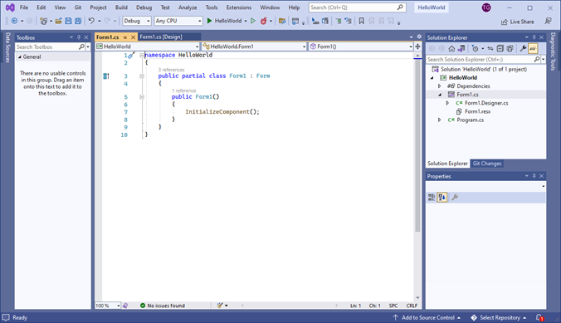
2.3 Introduction to c sharp Code
code is primarily organized in three ways: namespaces, classes, and methods
  Namespace: a container that holds classes
  Class: a container that holds methods
  Method: a group of one or more programming statements that perform some operations
A file that contains program code is called a source code file
Notes:
The Toolbox is on the left side of the screen. The code editor is in the center of the screen. A C sharp source code file is shown in the code editor. There are 10 lines of code, as follows. Line 1. Namespace hello underscore world. Line 2. Left brace. Line 3, indented once. Public partial class form 1 colon form. Line 4, indented once. Left brace. Line 5, indented twice. Public form 1 left parenthesis right parenthesis. Line 6, indented twice. Left brace. Line 7, indented three times. Initialize component left parenthesis right parenthesis semicolon. Line 8, indented twice. Right brace. Line 9, indented. right brace. Line 0. Right brace. The Solution Explorer window and the Properties window are on the right side of the screen.

Slide 27
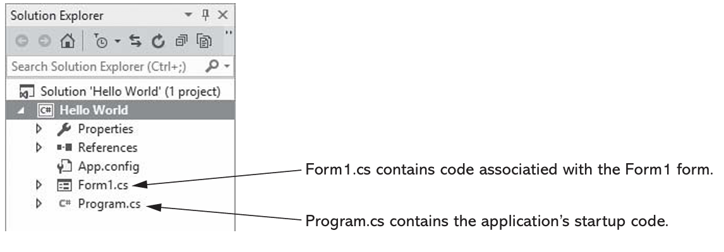
Source Code in the Solution Explorer (1 of 2)
Each time a new project is created the following two source code files are automatically created:
  Program.c s file: contains the application’s start-up code to be executed when the application runs
  Form1.c s contains code that is associated with the Form1 form

Slide 28
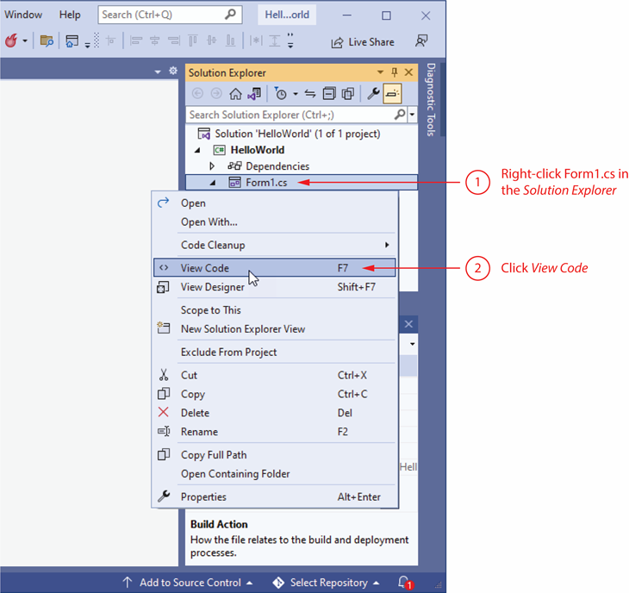
Source Code in the Solution Explorer (2 of 2)
You can open them through the Solution Explorer
Notes:
The menu that opens from right clicking the form option lists options including, open, open with, code cleanup, view code, view designer. 2, click view code.

Slide 29
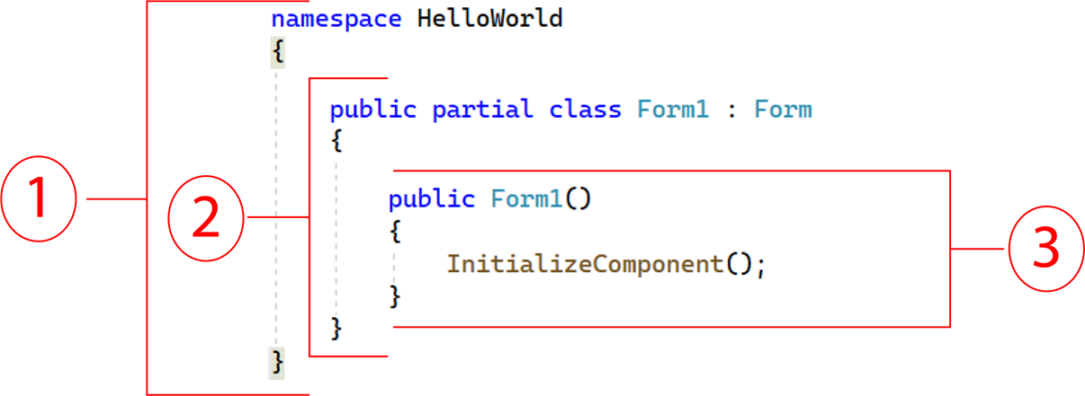
Organization of the Form1.c s
A sample of Form1.c s:
  The user-defined namespace of the project
  Class declaration
  A method
Notes:
The code is split into 3 sections, as follows. Section 1 contains lines 1 to 10. Section 2 is a subsection of section 1 and contains lines 3 to 9. Section 3 is a subsection of section 2 and contains lines 5 to 8. The code reads as follows. Line 1. Namespace hello world. Line 2. Left brace. Line 3, indented once. Public partial class form 1 colon form. Line 4, indented once. Left brace. Line 5, indented twice. Public form 1 left parenthesis right parenthesis. Line 6, indented twice. Left brace. Line 7, indented three times. Initialize component left parenthesis right parenthesis semicolon. Line 8, indented twice. Right brace. Line 9, indented. right brace. Line 10. Right brace.

Slide 30
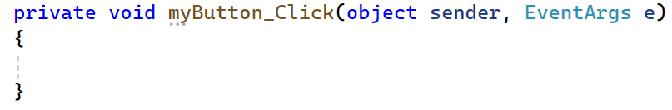
Adding Your Code
G U I applications are event-driven which means they respond to events that occur while the application is running
  This means the program waits for the user to do something (like clicking a button, typing, or moving the mouse) and then responds.
An event is a user’s action such as mouse clicking, key pressing, Moving
In the Designer, double clicking a control such as Button will link the control to a default Event Handler
  An event handler is a method that executes when a specific event takes place
  A code segment similar to the following will be created automatically:

Slide 31
Message Boxes
A message box (a k a dialog box) displays a message
.NET provides a method named MessageBox.Show
  The method displays a window with a message. A sample code is (bold line):
private void myButton_Click(object sender, EventArgs e)
{
MessageBox.Show("Thanks for clicking the button!");
}
  Placing it in the myButton_Click event handler can display the string in the message box when the button is clicked

Slide 32
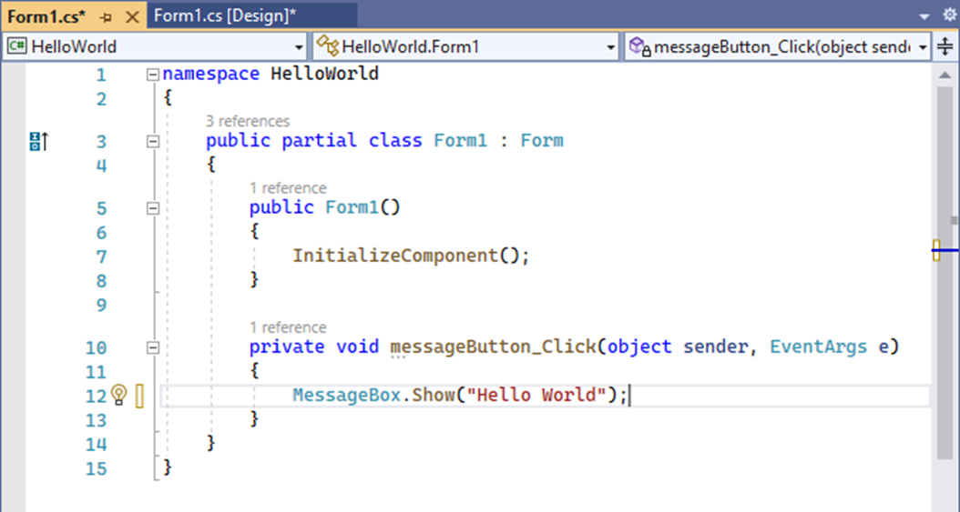
2.4 Writing Code for the Hello World Application
The completed source code of Form1.c s is:
Notes:
Line 1. Namespace hello world. Line 2. Left brace. Line 3, indented once. Public partial class form 1 colon form. Line 4, indented once. Left brace. Line 5, indented twice. Public form 1 left parenthesis right parenthesis. Line 6, indented twice. Left brace. Line 7, indented three times. Initialize component left parenthesis right parenthesis semicolon. Line 8, indented twice. Right brace. Line 9. Blank. Line 10, indented twice. Private void message button underscore click left parenthesis object sender comma event a r g s e right parenthesis. Line 11, indented twice. Left brace. Line 12, indented three times. Message box dot show left parenthesis double quotes hello world double quotes right parenthesis semicolon. Line 13, indented twice. Right brace. Line 14, indented once. Right brace. Line 15. Right brace.

Slide 33
2.5 Label Controls
A Label control displays text on a form and can be used to display unchanging text or program output
Commonly used properties are:
  Text: gets(read) or sets(write/change) the text associated with Label control
  Name: gets or sets the name of Label control
  Font: allows you to set the font, font style, and font size
  BorderStyle: allows you to display a border around the control’s text
  AutoSize: controls the way they can be resized
  TextAlign: set the text alignments

Slide 34
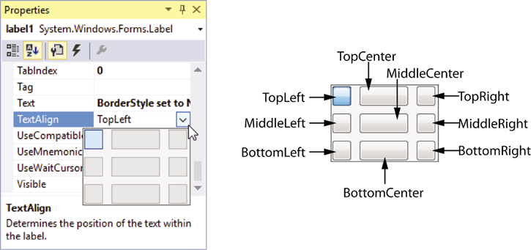
Handling Text Alignments
The TextAlign property supports the following values:
TopLeft | TopCenter | TopRight
MiddleLeft | MiddleCenter | MiddleRight
BottomLeft | BottomCenter | BottomRight
You can select them by clicking the down-arrow button of the TextAlign property
Notes:
The text align property is selected and a dropdown menu has nine placements in the label, as follows. Top left, top center, top right, middle left, middle center, middle right. Bottom left, bottom center, bottom right. The top left option is selected.

Slide 35
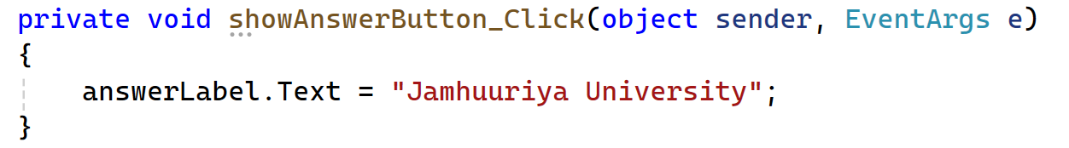
Using Code to Display Output in a Label Control
By adding the following bold line to a Button's event handler, a Label control can display output of the application.
Notice that
  the equal sign (=) is known as assignment operator
  the item receiving the value must be on the left of the = operator
  the Text property accepts a string only
  if you need to clear the text of a Label, simply assign an empty string ("") to clear the Text property
  answerLabel.Text = "";

Slide 36
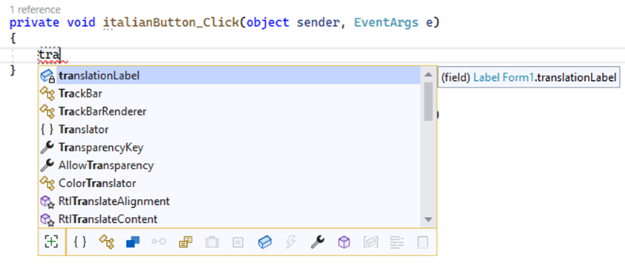
2.6 Making Sense of IntelliSense
IntelliSense provides automatic code completion as you write programming statements
IntelliSense is a smart code completion feature. As you type in your code, it automatically suggests possible keywords, variables, methods, classes, or properties that you might want to use.
It provides an array of options that make language references easily accessible
With it, you can find the information you need, and insert language elements directly into your code
Notes:
Line 1, indented. Private void Italian button underscore click left parenthesis object sender comma event a r g s e right parenthesis. Line 2, indented. Left brace. Line 3, indented twice. The letters t r and a are being typed and the computer displays several drop down options of code containing the letters t r and a. The first option is translation label, and it is highlighted. Line 4. Right brace.

Slide 37
2.7 PictureBox Controls
A PictureBox control displays a graphic image on a form
Commonly used properties are:
  Image: specifies the image that it will display
  SizeMode: specifies how the control’s image is to be displayed
  Visible: determines whether the control is visible on the form at run time

Slide 38
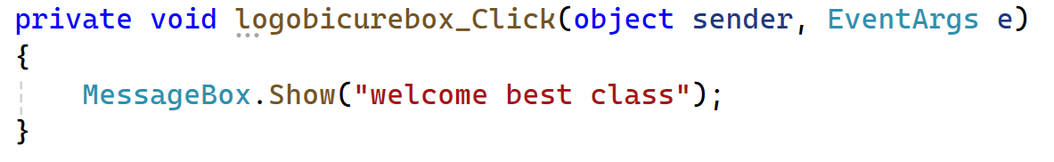
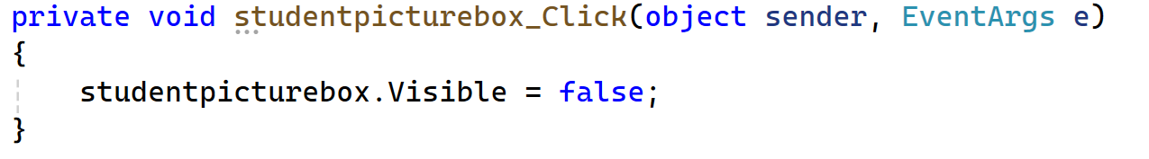
Creating Clickable Images
You can double click the PictureBox control in the Designer to create a Click event handler and then add your codes to it. For example,
And

Slide 39
Sequential Execution of Statements
Programmers need to carefully arrange the sequence of statements in order to generate the correct results
In the following example, the statements in the method execute in the order that they appear:
private void showBackButton_Click(object sender, EventArgs e)
{
cardBackPictureBox.Visible = true;
cardFacePictureBox.Visible = false;
}
This makes sense because when you click the button, you want to flip the card: back is visible, face is hidden.
private void showBackButton_Click(object sender, EventArgs e)
{
cardBackPictureBox.Visible = False;
cardFacePictureBox.Visible = false;
}
What happens here? First line hides the face second line also hides the back. Result: Both pictures are hidden.
Incorrect arrangement of sequence can cause logic errors

Slide 40
2.8 Comments, Blank Links, and Indentation
Comments are brief notes that are placed in a program’s source code to explain how parts of the program work
A line comment appears on one line in a program
// Make image of the card back visible.
cardBackPictureBox.Visible = true;
A block comment can occupy multiple consecutive lines in a program
/*
Line one
Line two
*/

Slide 41
Using Blank Lines and Indentation (1 of 2)
Programmers frequently use blank lines and indentation in their codes to make the code more human-readable
Compare the following two identical codes:
namespace Wage_Calculator
{
public partial class Form1 : Form
{
public Form1()
{
lnitializeComponent();
}
private void exitButton_Click(object sender, EventArgs e)
{
// Close the form.
this.Close();
}
}
}

Slide 42
Using Blank Lines and Indentation (2 of 2)
namespace Wage_ Calculator
{
public partial class Form1 : Form
{
public Form1()
{
lnitializeComponent();
}
private void exitButton_ Click(object sender, EventArgs e)
{
// Close the form.
this. Close();
}
}
}

Slide 43
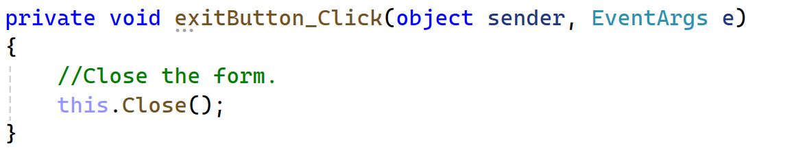
2.9 Writing the Code to Close an Application’s Form
To close an application’s form in code, use the following statement:
this.Close();
A commonly used practice is to create an Exit button and manually add the code to it:
Application.Exit;
Notes:
this.Close(); // closes the current form (Form1)
Application.Exit(); // closes the whole application
2. JavaScript (Browser environment)
window.close(); // closes the current browser window (only works if it was opened with JavaScript)
document.getElementById("myForm").style.display = "none";
React (JSX framework)
<button onClick={() => setShowForm(false)}>Close Form</button>
Java (Swing GUI)
this.dispose(); // closes the current JFrame (Form)
System.exit(0); // exits the entire application

Slide 44
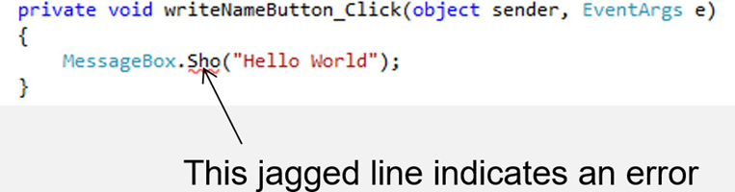
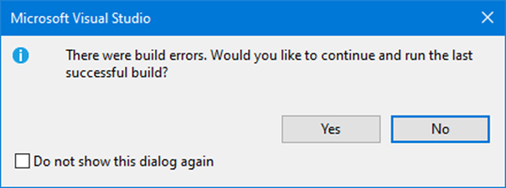
2.10 Dealing with Syntax Errors
The Visual Studio code editor examines each statement as you type it and reports any syntax errors that are found
If a syntax error is found, it is underlined with a jagged line
If a syntax error exists and you attempt to compile and execute, you will see the following window
Notes:
Line 1. Private void write name button underscore click left parenthesis object sender comma event a r g s e right parenthesis. Line 2. Left brace. Line 3, indented. Message box dot s h o right parenthesis double quote hello world double quote right parenthesis semicolon. Line 4. Right brace. There is an arrow pointing to s h o in line 3 and s h o has a red jagged line under it. The jagged line indicates an error.

Slide 45
Copyright
This work is protected by United States copyright laws and is provided solely for the use of instructors in teaching their courses and assessing student learning. Dissemination or sale of any part of this work (including on the World Wide Web) will destroy the integrity of the work and is not permitted. The work and materials from it should never be made available to students except by instructors using the accompanying text in their classes. All recipients of this work are expected to abide by these restrictions and to honor the intended pedagogical purposes and the needs of other instructors who rely on these materials.

